Slide 1
ICDSS Lecture 4: Neural Networks
Instructor: Myungchan Kim, Chemical Engineering

Slide 2
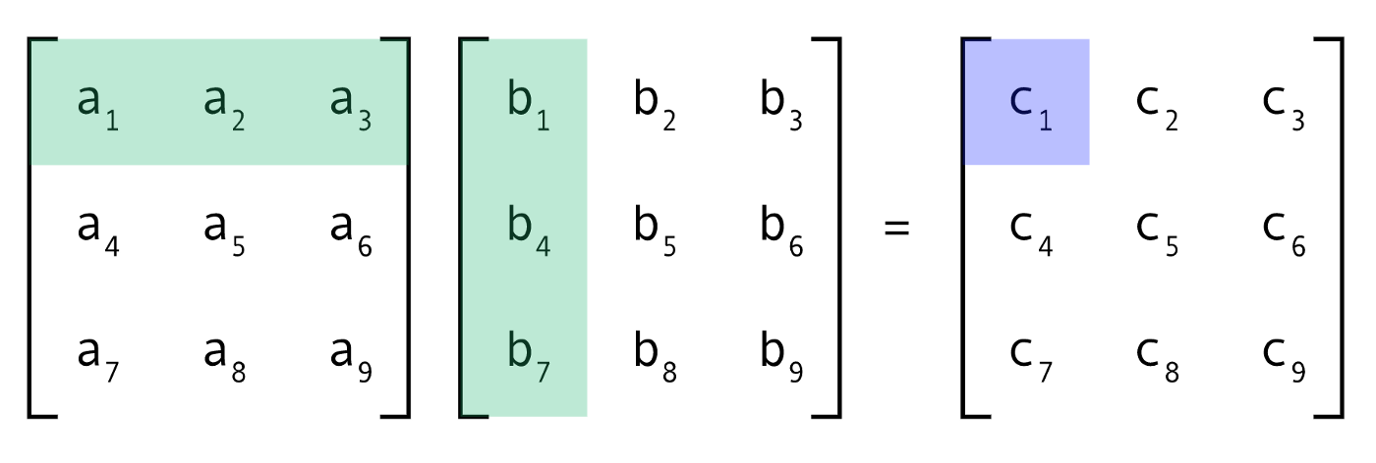
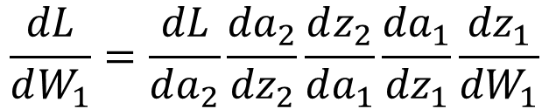
"Pre-requisites" of L4
Not a mathematically rigorous lecture. We assume you know:
Matrix Multiplication
Chain Rule
Linear and Logistic Regression
$$\frac{dL}{dW_{1}}=\frac{dL}{da_{2}}\frac{{da}_{2}}{{dz}_{2}}\frac{dz_{2}}{da_{1}}\frac{{da}_{1}}{{dz}_{1}}\frac{{dz}_{1}}{{dW}_{1}}$$
Credit: https://charchithowitzer.medium.com/matrix-multiplication-why-is-it-a-big-deal-cc8ef7490008

Slide 3
Overview of L4
1
2
3
Linear Regression as a NN
Logistic Regression as a NN
General NNs

Slide 4
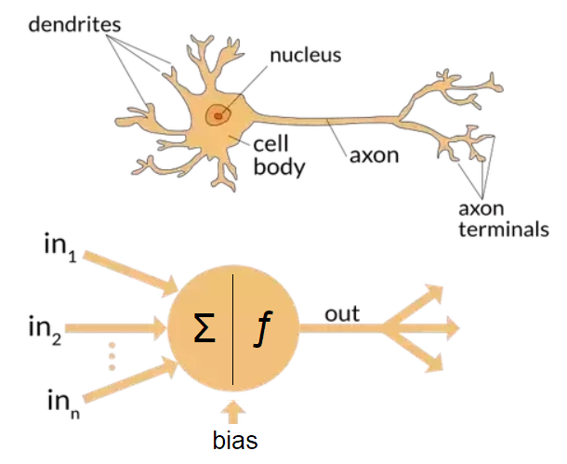
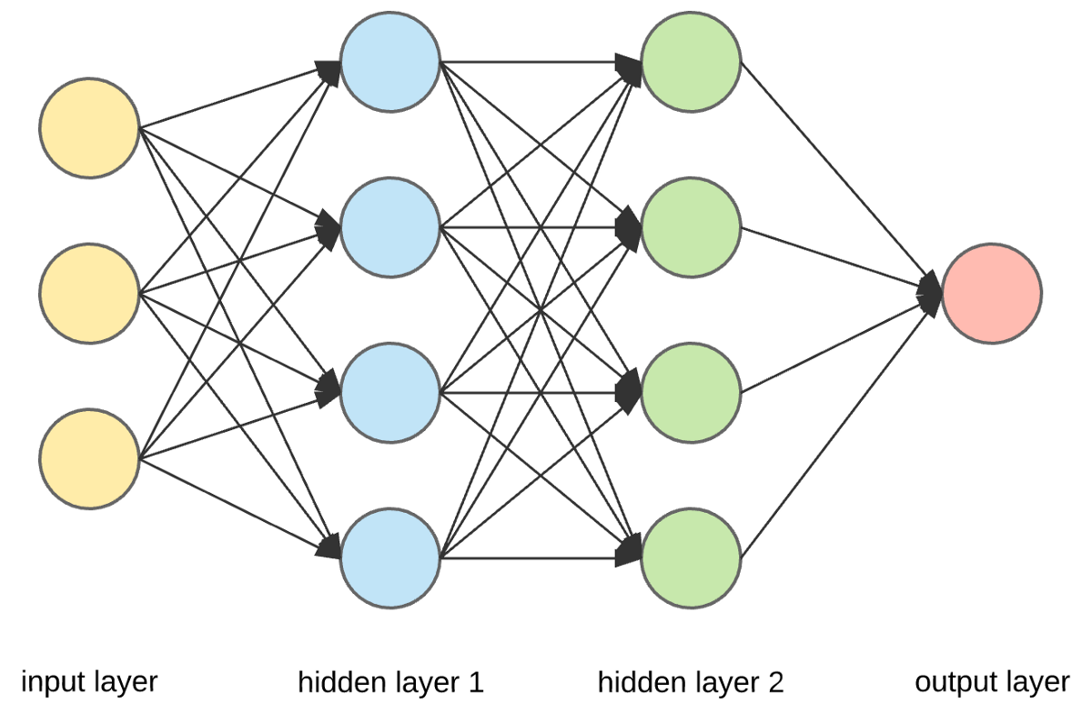
Why are they called Neural Networks?
Mimics the human brain (not exactly!)
Output signals from other neurons as the input
Each signal has a different “weighting”
If signal is above some threshold value, it is “activated.”
Credit: https://charchithowitzer.medium.com/matrix-multiplication-why-is-it-a-big-deal-cc8ef7490008
Notes:
Give a "spoiler" of sorts by starting with this diagram.
Usually, people use these terms interchangeably. But each word has its own nuance. (And then briefly explain the diagram).
How I envision this lecture and this series of lectures is essentially starting from the bigger picture and then constantly working our way down; our whole lecture series are structured in this way (By using lots of real life examples). I want to first start off by talking about what artificial intelligence is in general and then start by scratching the surface of ML. Lecture 2 will get more into Machine Learning, where the lecture will be based on a real project, teaching some useful Python Packages. Then after that, we will cover all of ML. After covering ML, we will move onto Neural Networks and Deep learning (where arguably all the exciting projects and case studies are)

Slide 5
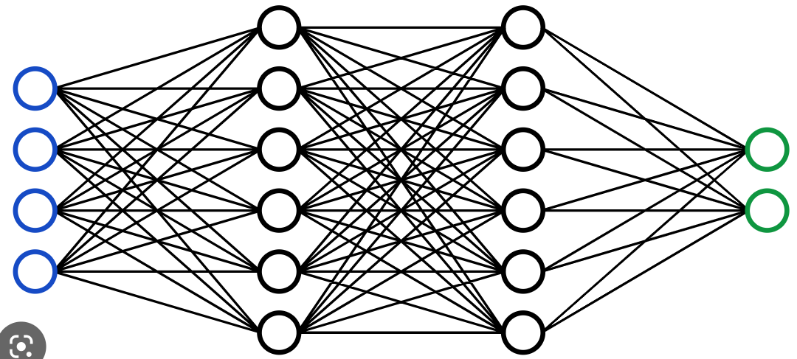


Some Notation
Input, Label Matrix: $X, Y$
Prediction Matrix: $\hat{y}$
Number Of Layers: All layers excluding input
Input Layer: Layer 0
Number of examples: m
Input, Label Size: $n_{x},$ $n_{y}$
Credit: https://medium.com/@marcellvollmer/how-to-make-it-simple-to-explain-ai-ml-dl-and-data-science-a49e54d54a12
Notes:
Give a "spoiler" of sorts by starting with this diagram.
Usually, people use these terms interchangeably. But each word has its own nuance. (And then briefly explain the diagram).
How I envision this lecture and this series of lectures is essentially starting from the bigger picture and then constantly working our way down; our whole lecture series are structured in this way (By using lots of real life examples). I want to first start off by talking about what artificial intelligence is in general and then start by scratching the surface of ML. Lecture 2 will get more into Machine Learning, where the lecture will be based on a real project, teaching some useful Python Packages. Then after that, we will cover all of ML. After covering ML, we will move onto Neural Networks and Deep learning (where arguably all the exciting projects and case studies are)

Slide 6
Neural Networks: General Steps
1
Random Initialisation
2
3
4
Forward Propagation
Backpropagation
Update Parameters
Repeat
Notes:
Give a "spoiler" of sorts by starting with this diagram.
Usually, people use these terms interchangeably. But each word has its own nuance. (And then briefly explain the diagram).
How I envision this lecture and this series of lectures is essentially starting from the bigger picture and then constantly working our way down; our whole lecture series are structured in this way (By using lots of real life examples). I want to first start off by talking about what artificial intelligence is in general and then start by scratching the surface of ML. Lecture 2 will get more into Machine Learning, where the lecture will be based on a real project, teaching some useful Python Packages. Then after that, we will cover all of ML. After covering ML, we will move onto Neural Networks and Deep learning (where arguably all the exciting projects and case studies are)

Slide 7
Linear Regression (Single Feature)

Slide 8
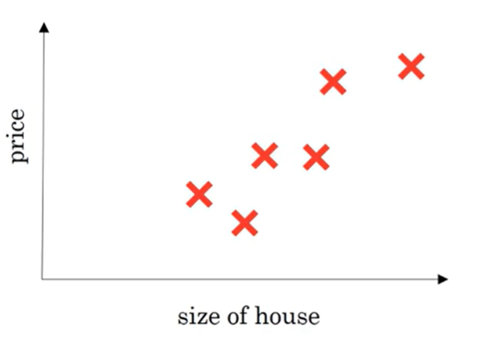

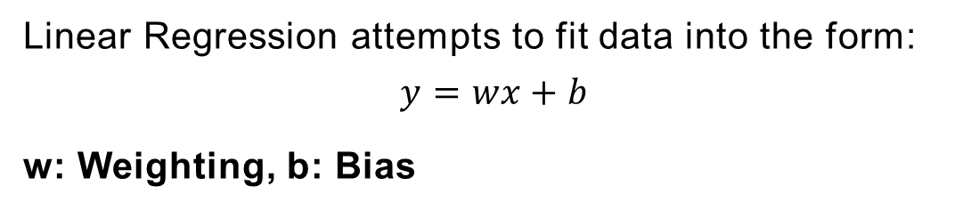
Linear Regression (Single Feature):
Consider a single feature linear regression problem:
Predicting House Price based on Total Size
Linear Regression attempts to fit data into the form:
$$y=wx+b$$
w: Weighting, b: Bias
This can be visualised as a “Neural Network”
X
w
$$\hat{y}$$
“Neuron”
Credit: deeplearning.ai
Notes:
Give a "spoiler" of sorts by starting with this diagram.
Usually, people use these terms interchangeably. But each word has its own nuance. (And then briefly explain the diagram).
How I envision this lecture and this series of lectures is essentially starting from the bigger picture and then constantly working our way down; our whole lecture series are structured in this way (By using lots of real life examples). I want to first start off by talking about what artificial intelligence is in general and then start by scratching the surface of ML. Lecture 2 will get more into Machine Learning, where the lecture will be based on a real project, teaching some useful Python Packages. Then after that, we will cover all of ML. After covering ML, we will move onto Neural Networks and Deep learning (where arguably all the exciting projects and case studies are)

Slide 9
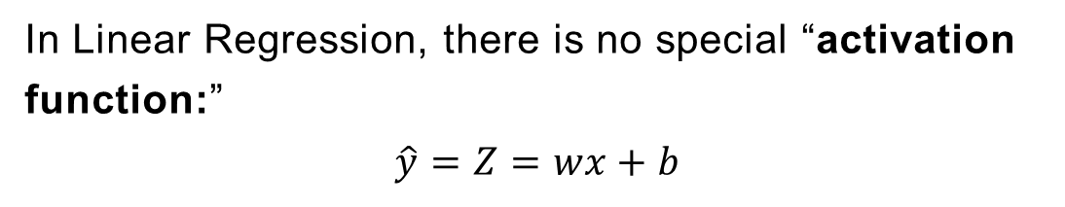
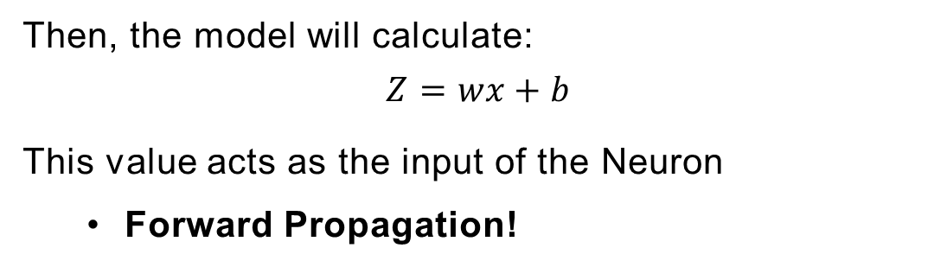

Linear Regression (Single Feature):
First, the "network" will randomly guess w and b.
Then, the model will calculate:
$$Z=wx+b$$
This value acts as the input of the Neuron
Forward Propagation!
X
w
$$\hat{y}$$
“Neuron”
In Linear Regression, there is no special “activation function:”
$$\hat{y}=Z=wx+b$$
Credit: deeplearning.ai
Notes:
Give a "spoiler" of sorts by starting with this diagram.
Usually, people use these terms interchangeably. But each word has its own nuance. (And then briefly explain the diagram).
How I envision this lecture and this series of lectures is essentially starting from the bigger picture and then constantly working our way down; our whole lecture series are structured in this way (By using lots of real life examples). I want to first start off by talking about what artificial intelligence is in general and then start by scratching the surface of ML. Lecture 2 will get more into Machine Learning, where the lecture will be based on a real project, teaching some useful Python Packages. Then after that, we will cover all of ML. After covering ML, we will move onto Neural Networks and Deep learning (where arguably all the exciting projects and case studies are)

Slide 10
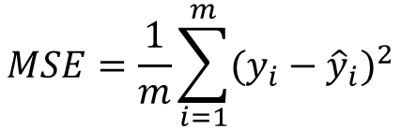
Linear Regression (Single Feature):
The “network” just guessed values, predictions can’t be accurate
A loss function (performance measure) needs to be defined and minimised
Use Mean Squared Error (MSE)
$$MSE=\frac{1}{m}\sum_{i=1}^{m}{(y_{i}−{\hat{y}}_{i})^{2}}$$
How do we change the parameters (such as w) so that we minimize the MSE?
Update the value of the parameter using its gradient (gradient descent)
Credit: deeplearning.ai
Notes:
Give a "spoiler" of sorts by starting with this diagram.
Usually, people use these terms interchangeably. But each word has its own nuance. (And then briefly explain the diagram).
How I envision this lecture and this series of lectures is essentially starting from the bigger picture and then constantly working our way down; our whole lecture series are structured in this way (By using lots of real life examples). I want to first start off by talking about what artificial intelligence is in general and then start by scratching the surface of ML. Lecture 2 will get more into Machine Learning, where the lecture will be based on a real project, teaching some useful Python Packages. Then after that, we will cover all of ML. After covering ML, we will move onto Neural Networks and Deep learning (where arguably all the exciting projects and case studies are)

Slide 11




Linear Regression (Single Feature):
How do we change the parameters (such as w) of the network to minimize the MSE?
Examine how MSE is calculated in terms of a computation diagram
b
w
$$Z=wx+b$$
$$\hat{y}=Z$$
MSE
Consider derivatives of MSE with respect to w and b
Use chain rule to get
$$\frac{d(MSE)}{dw}=\frac{d(MSE)}{d\hat{y}}\frac{d\hat{y}}{dZ}\frac{dZ}{dw}$$
$$\frac{d(MSE)}{db}=\frac{d(MSE)}{d\hat{y}}\frac{d\hat{y}}{dZ}\frac{dZ}{db}$$
See that we are calculating derivatives from the output layer to the input layer (backwards)
Backpropagation!
Credit: deeplearning.ai
Notes:
Give a "spoiler" of sorts by starting with this diagram.
Usually, people use these terms interchangeably. But each word has its own nuance. (And then briefly explain the diagram).
How I envision this lecture and this series of lectures is essentially starting from the bigger picture and then constantly working our way down; our whole lecture series are structured in this way (By using lots of real life examples). I want to first start off by talking about what artificial intelligence is in general and then start by scratching the surface of ML. Lecture 2 will get more into Machine Learning, where the lecture will be based on a real project, teaching some useful Python Packages. Then after that, we will cover all of ML. After covering ML, we will move onto Neural Networks and Deep learning (where arguably all the exciting projects and case studies are)

Slide 12

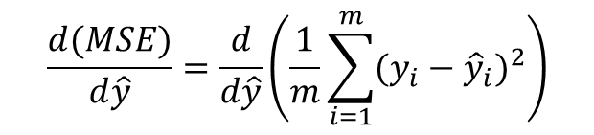
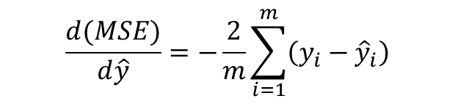
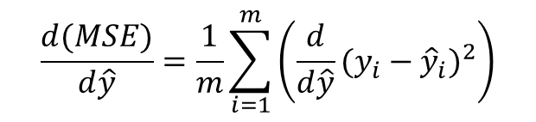

Linear Regression (Single Feature):
Consider derivatives of MSE with respect to w and b
Use chain rule to get:
$$\frac{d(MSE)}{dw}=\frac{d(MSE)}{d\hat{y}}\frac{d\hat{y}}{dZ}\frac{dZ}{dw}$$
$$\frac{d(MSE)}{db}=\frac{d(MSE)}{d\hat{y}}\frac{d\hat{y}}{dZ}\frac{dZ}{db}$$
$$\frac{d(MSE)}{d\hat{y}}=\frac{d}{d\hat{y}}\left(\frac{1}{m}\sum_{i=1}^{m}{(y_{i}−{\hat{y}}_{i})^{2}}\right)$$
$$\frac{d(MSE)}{d\hat{y}}=\frac{1}{m}\sum_{i=1}^{m}{\left(\frac{d}{d\hat{y}}(y_{i}−{\hat{y}}_{i})^{2}\right)}$$
$$\frac{d(MSE)}{d\hat{y}}=−\frac{2}{m}\sum_{i=1}^{m}{\left(y_{i}−{\hat{y}}_{i}\right)}$$
Notes:
Give a "spoiler" of sorts by starting with this diagram.
Usually, people use these terms interchangeably. But each word has its own nuance. (And then briefly explain the diagram).
How I envision this lecture and this series of lectures is essentially starting from the bigger picture and then constantly working our way down; our whole lecture series are structured in this way (By using lots of real life examples). I want to first start off by talking about what artificial intelligence is in general and then start by scratching the surface of ML. Lecture 2 will get more into Machine Learning, where the lecture will be based on a real project, teaching some useful Python Packages. Then after that, we will cover all of ML. After covering ML, we will move onto Neural Networks and Deep learning (where arguably all the exciting projects and case studies are)

Slide 13
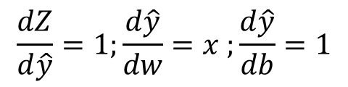
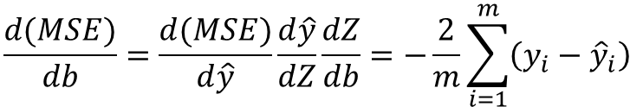
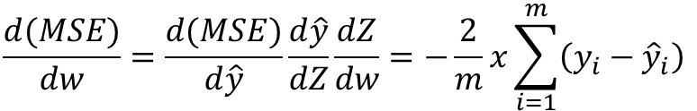
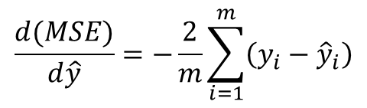
Linear Regression (Single Feature):
Consider derivatives of MSE with respect to w and b
$$Z=wx+b$$
$$\frac{d(MSE)}{d\hat{y}}=−\frac{2}{m}\sum_{i=1}^{m}{\left(y_{i}−{\hat{y}}_{i}\right)}$$
$$\frac{dZ}{d\hat{y}}=1;\frac{d\hat{y}}{dw}=x ;\frac{d\hat{y}}{db}=1$$
$$\frac{d(MSE)}{dw}=\frac{d(MSE)}{d\hat{y}}\frac{d\hat{y}}{dZ}\frac{dZ}{dw}=−\frac{2}{m}x\sum_{i=1}^{m}{\left(y_{i}−{\hat{y}}_{i}\right)}$$
$$\frac{d(MSE)}{db}=\frac{d(MSE)}{d\hat{y}}\frac{d\hat{y}}{dZ}\frac{dZ}{db}=−\frac{2}{m}\sum_{i=1}^{m}{\left(y_{i}−{\hat{y}}_{i}\right)}$$
Notes:
Give a "spoiler" of sorts by starting with this diagram.
Usually, people use these terms interchangeably. But each word has its own nuance. (And then briefly explain the diagram).
How I envision this lecture and this series of lectures is essentially starting from the bigger picture and then constantly working our way down; our whole lecture series are structured in this way (By using lots of real life examples). I want to first start off by talking about what artificial intelligence is in general and then start by scratching the surface of ML. Lecture 2 will get more into Machine Learning, where the lecture will be based on a real project, teaching some useful Python Packages. Then after that, we will cover all of ML. After covering ML, we will move onto Neural Networks and Deep learning (where arguably all the exciting projects and case studies are)

Slide 14

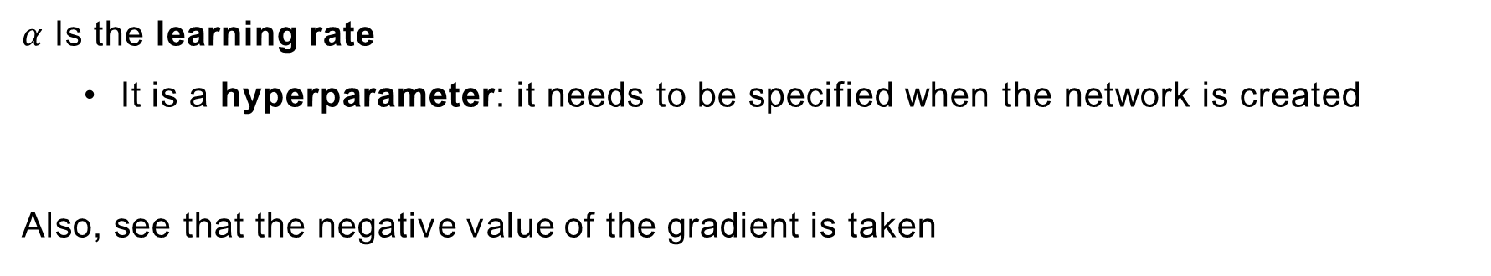



Linear Regression (Single Feature):
The gradients can be used to update parameters (also known as “learning”)
$$\frac{d(MSE)}{dw}=\frac{d(MSE)}{d\hat{y}}\frac{d\hat{y}}{dZ}\frac{dZ}{dw}$$
$$\frac{d(MSE)}{db}=\frac{d(MSE)}{d\hat{y}}\frac{d\hat{y}}{dZ}\frac{dZ}{db}$$
Update as following:
$$w →w−α\frac{d(MSE)}{dw}$$
$$b→b−α\frac{d(MSE)}{db}$$
$α$ Is the learning rate
It is a hyperparameter: it needs to be specified when the network is created
Also, see that the negative value of the gradient is taken
Notes:
Give a "spoiler" of sorts by starting with this diagram.
Usually, people use these terms interchangeably. But each word has its own nuance. (And then briefly explain the diagram).
How I envision this lecture and this series of lectures is essentially starting from the bigger picture and then constantly working our way down; our whole lecture series are structured in this way (By using lots of real life examples). I want to first start off by talking about what artificial intelligence is in general and then start by scratching the surface of ML. Lecture 2 will get more into Machine Learning, where the lecture will be based on a real project, teaching some useful Python Packages. Then after that, we will cover all of ML. After covering ML, we will move onto Neural Networks and Deep learning (where arguably all the exciting projects and case studies are)

Slide 15
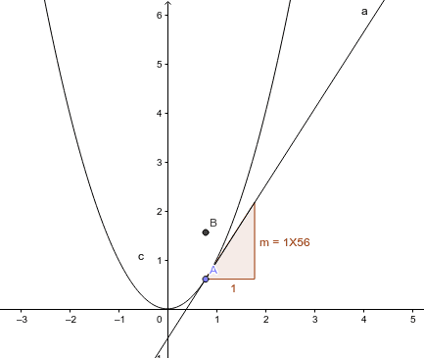


Linear Regression (Single Feature):
Why are the negative values of gradients used?
$$w →w−α\frac{d(MSE)}{dw}$$
$$b→b−α\frac{d(MSE)}{db}$$
The gradient points towards the direction with the steepest increase
To get direction of steepest decrease, the negative value should be taken
Forward, Backpropagation and Updating of parameters will repeat for a set number of “epochs”
Credit: deeplearning.ai
Notes:
Give a "spoiler" of sorts by starting with this diagram.
Usually, people use these terms interchangeably. But each word has its own nuance. (And then briefly explain the diagram).
How I envision this lecture and this series of lectures is essentially starting from the bigger picture and then constantly working our way down; our whole lecture series are structured in this way (By using lots of real life examples). I want to first start off by talking about what artificial intelligence is in general and then start by scratching the surface of ML. Lecture 2 will get more into Machine Learning, where the lecture will be based on a real project, teaching some useful Python Packages. Then after that, we will cover all of ML. After covering ML, we will move onto Neural Networks and Deep learning (where arguably all the exciting projects and case studies are)

Slide 16
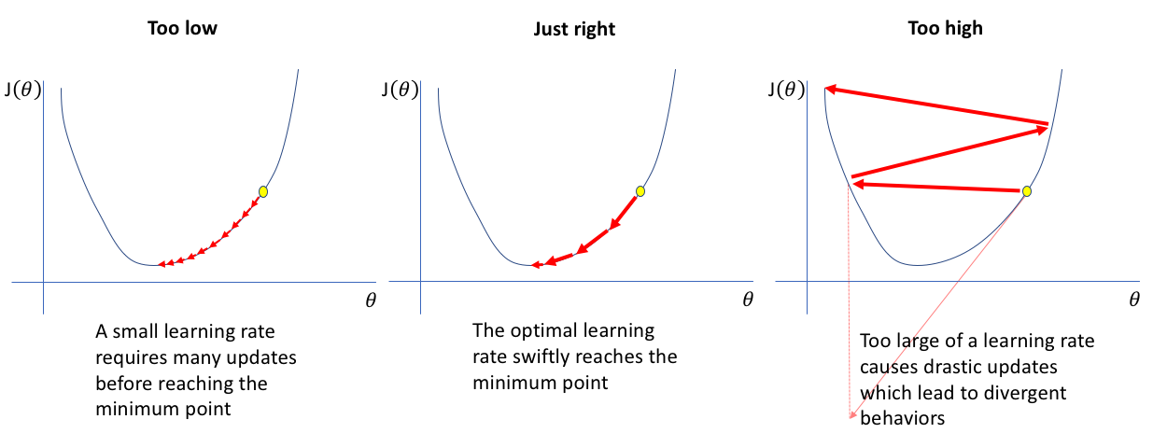
Linear Regression (Single Feature):
Finding the right value for the learning rate can be an iterative process
$$w →w−α\frac{d(MSE)}{dw}$$
$$b→b−α\frac{d(MSE)}{db}$$
Credit:. https://www.jeremyjordan.me/nn-learning-rate/ i
Notes:
Give a "spoiler" of sorts by starting with this diagram.
Usually, people use these terms interchangeably. But each word has its own nuance. (And then briefly explain the diagram).
How I envision this lecture and this series of lectures is essentially starting from the bigger picture and then constantly working our way down; our whole lecture series are structured in this way (By using lots of real life examples). I want to first start off by talking about what artificial intelligence is in general and then start by scratching the surface of ML. Lecture 2 will get more into Machine Learning, where the lecture will be based on a real project, teaching some useful Python Packages. Then after that, we will cover all of ML. After covering ML, we will move onto Neural Networks and Deep learning (where arguably all the exciting projects and case studies are)

Slide 17
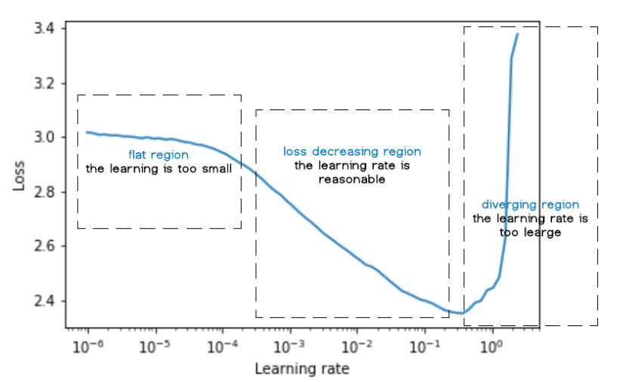
Linear Regression (Single Feature):
Starting from very small values, evaluate the loss of the model using a validation set
$$w →w−α\frac{d(MSE)}{dw}$$
$$b→b−α\frac{d(MSE)}{db}$$
Credit:. https://medium.com/deep-learning-hk/some-techniques-in-deep-learning-optimization-1-learning-rate-b4669d5bb568#:~:text=Learning%20Rate%20Range%20Test,-The%20idea%20is&text=Select%20a%20validation%20set,when%20the%20training%20starts%20diverging
Notes:
Give a "spoiler" of sorts by starting with this diagram.
Usually, people use these terms interchangeably. But each word has its own nuance. (And then briefly explain the diagram).
How I envision this lecture and this series of lectures is essentially starting from the bigger picture and then constantly working our way down; our whole lecture series are structured in this way (By using lots of real life examples). I want to first start off by talking about what artificial intelligence is in general and then start by scratching the surface of ML. Lecture 2 will get more into Machine Learning, where the lecture will be based on a real project, teaching some useful Python Packages. Then after that, we will cover all of ML. After covering ML, we will move onto Neural Networks and Deep learning (where arguably all the exciting projects and case studies are)

Slide 18





Linear Regression (Single Feature):
In Summary:
X
w
Z
$$\hat{y}$$
1.Random Initialisation: Neural Network assigns random values to W and b.
2.Forward Propagation: The Network Calculates:
$Z=wx+b ; \hat{y}=Z$
3.Backpropagation: The network calculates derivatives to minimise the loss function
$$\frac{d(MSE)}{dw}=\frac{d(MSE)}{d\hat{y}}\frac{d\hat{y}}{dZ}\frac{dZ}{dw}$$
$$\frac{d(MSE)}{db}=\frac{d(MSE)}{d\hat{y}}\frac{d\hat{y}}{dZ}\frac{dZ}{db}$$
4.Update Parameters: Using the gradients, parameters (w,b) are updated
$$w →w−α\frac{d(MSE)}{dw}$$
$$b→b−α\frac{d(MSE)}{db}$$
5.Repeat 2-4 for a set number of “Epochs”
Notes:
Give a "spoiler" of sorts by starting with this diagram.
Usually, people use these terms interchangeably. But each word has its own nuance. (And then briefly explain the diagram).
How I envision this lecture and this series of lectures is essentially starting from the bigger picture and then constantly working our way down; our whole lecture series are structured in this way (By using lots of real life examples). I want to first start off by talking about what artificial intelligence is in general and then start by scratching the surface of ML. Lecture 2 will get more into Machine Learning, where the lecture will be based on a real project, teaching some useful Python Packages. Then after that, we will cover all of ML. After covering ML, we will move onto Neural Networks and Deep learning (where arguably all the exciting projects and case studies are)

Slide 19
Linear Regression (Multiple Features)

Slide 20
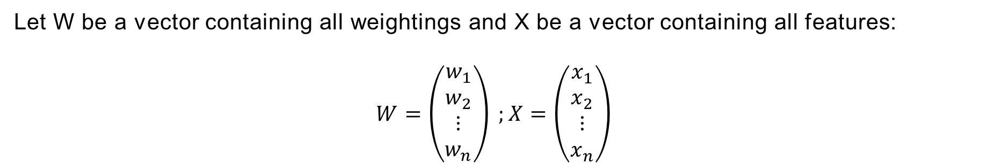
Linear Regression:
What if there are multiple features?
Predicting House Price based on House Size ($x_{1}$), Number of Toilets ($x_{2}$),…,($x_{n}$)
Linear Regression attempts to fit data into the form:
$$y=w_{1}x_{1}+w_{2}x_{2}+w_{3}x_{3}+…+w_{n}x_{n}+b$$
Let W be a vector containing all weightings and X be a vector containing all features:
$$W=\left(\begin{matrix}\begin{matrix}w_{1} \\ w_{2}\end{matrix} \\ ⋮ \\ w_{n}\end{matrix}\right) ;X=\left(\begin{matrix}\begin{matrix}x_{1} \\ x_{2}\end{matrix} \\ ⋮ \\ x_{n}\end{matrix}\right)$$
In terms of Matrix Multiplication:
$$Y=W^{T}X+b$$
Notes:
Give a "spoiler" of sorts by starting with this diagram.
Usually, people use these terms interchangeably. But each word has its own nuance. (And then briefly explain the diagram).
How I envision this lecture and this series of lectures is essentially starting from the bigger picture and then constantly working our way down; our whole lecture series are structured in this way (By using lots of real life examples). I want to first start off by talking about what artificial intelligence is in general and then start by scratching the surface of ML. Lecture 2 will get more into Machine Learning, where the lecture will be based on a real project, teaching some useful Python Packages. Then after that, we will cover all of ML. After covering ML, we will move onto Neural Networks and Deep learning (where arguably all the exciting projects and case studies are)

Slide 21







Linear Regression Example:
This can be illustrated as a neural network:
$$x_{1}$$
$${Z=W}^{T}X+b$$
$$x_{2}$$
Z
$$\hat{y}$$
$$⋮$$
$$\hat{y}=Z$$
$$x_{n}$$
Forward Propagation:
$$w_{1}x_{1}+w_{2}x_{2}+w_{3}x_{3}+…+w_{n}x_{n}+b$$
Just like before, the network will first assign random values to $w_{1}{,w}_{2},…,w_{n},b$
Credit: deeplearning.ai
Notes:
Give a "spoiler" of sorts by starting with this diagram.
Usually, people use these terms interchangeably. But each word has its own nuance. (And then briefly explain the diagram).
How I envision this lecture and this series of lectures is essentially starting from the bigger picture and then constantly working our way down; our whole lecture series are structured in this way (By using lots of real life examples). I want to first start off by talking about what artificial intelligence is in general and then start by scratching the surface of ML. Lecture 2 will get more into Machine Learning, where the lecture will be based on a real project, teaching some useful Python Packages. Then after that, we will cover all of ML. After covering ML, we will move onto Neural Networks and Deep learning (where arguably all the exciting projects and case studies are)

Slide 22
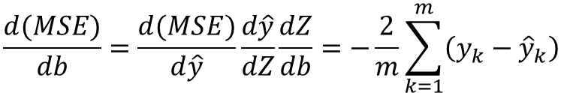
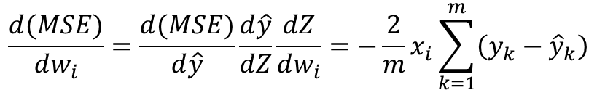


Linear Regression Example:
$w_{1}{,w}_{2},…,w_{n},b$need to be modified
$$\frac{d(MSE)}{dw_{1}};\frac{d(MSE)}{dw_{2}};…;\frac{d\left(MSE\right)}{dw_{n}};\frac{d(MSE)}{db}$$
Follow similar workings to single variable linear regression:
$$\frac{d(MSE)}{dw_{i}}=\frac{d(MSE)}{d\hat{y}}\frac{d\hat{y}}{dZ}\frac{dZ}{dw_{i}}$$
$$\frac{d(MSE)}{dw_{i}}=\frac{d(MSE)}{d\hat{y}}\frac{d\hat{y}}{dZ}\frac{dZ}{dw_{i}}=−\frac{2}{m}x_{i}\sum_{k=1}^{m}{\left(y_{k}−{\hat{y}}_{k}\right)}$$
$$\frac{d(MSE)}{db}=\frac{d(MSE)}{d\hat{y}}\frac{d\hat{y}}{dZ}\frac{dZ}{db}=−\frac{2}{m}\sum_{k=1}^{m}{\left(y_{k}−{\hat{y}}_{k}\right)}$$
Notes:
Give a "spoiler" of sorts by starting with this diagram.
Usually, people use these terms interchangeably. But each word has its own nuance. (And then briefly explain the diagram).
How I envision this lecture and this series of lectures is essentially starting from the bigger picture and then constantly working our way down; our whole lecture series are structured in this way (By using lots of real life examples). I want to first start off by talking about what artificial intelligence is in general and then start by scratching the surface of ML. Lecture 2 will get more into Machine Learning, where the lecture will be based on a real project, teaching some useful Python Packages. Then after that, we will cover all of ML. After covering ML, we will move onto Neural Networks and Deep learning (where arguably all the exciting projects and case studies are)

Slide 23



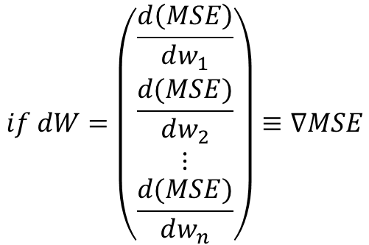


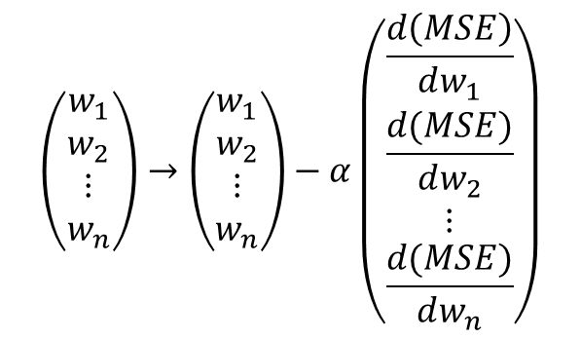
Linear Regression Example:
With the gradients and the learning rate, update the parameters
$$w_{1} →w_{1}−α\frac{d\left(MSE\right)}{dw_{1}}$$
$$w_{2} →w_{2}−α\frac{d(MSE)}{dw_{2}}$$
$$w_{n} →w_{n}−α\frac{d(MSE)}{dw_{n}}$$
$$b→b−α\frac{d(MSE)}{db}$$
In terms of vectors:
$$\left(\begin{matrix}\begin{matrix}w_{1} \\ w_{2}\end{matrix} \\ ⋮ \\ w_{n}\end{matrix}\right)→\left(\begin{matrix}\begin{matrix}w_{1} \\ w_{2}\end{matrix} \\ ⋮ \\ w_{n}\end{matrix}\right)−α\left(\begin{matrix}\begin{matrix}\frac{d\left(MSE\right)}{dw_{1}} \\ \frac{d(MSE)}{dw_{2}}\end{matrix} \\ ⋮ \\ \frac{d(MSE)}{dw_{n}}\end{matrix}\right)$$
$$if dW=\left(\begin{matrix}\begin{matrix}\frac{d\left(MSE\right)}{dw_{1}} \\ \frac{d(MSE)}{dw_{2}}\end{matrix} \\ ⋮ \\ \frac{d(MSE)}{dw_{n}}\end{matrix}\right)≡∇MSE$$
$W→W−αdW$
Notes:
Give a "spoiler" of sorts by starting with this diagram.
Usually, people use these terms interchangeably. But each word has its own nuance. (And then briefly explain the diagram).
How I envision this lecture and this series of lectures is essentially starting from the bigger picture and then constantly working our way down; our whole lecture series are structured in this way (By using lots of real life examples). I want to first start off by talking about what artificial intelligence is in general and then start by scratching the surface of ML. Lecture 2 will get more into Machine Learning, where the lecture will be based on a real project, teaching some useful Python Packages. Then after that, we will cover all of ML. After covering ML, we will move onto Neural Networks and Deep learning (where arguably all the exciting projects and case studies are)

Slide 24


Linear Regression
In Summary:
X
W
Z
$$\hat{y}$$
1.Random Initialisation: Neural Network assigns random values to W and b.
2.Foreward Propagation: The Network Calculates:
$Z=W^{T}X+b ; \hat{y}=Z$
3.Backpropagation: The network calculates derivatives to minimise the loss function
$$\frac{d(MSE)}{dw_{i}}=\frac{d(MSE)}{d\hat{y}}\frac{d\hat{y}}{dZ}\frac{dZ}{dw_{i}}$$
$$\frac{d(MSE)}{db}=\frac{d(MSE)}{d\hat{y}}\frac{d\hat{y}}{dZ}\frac{dZ}{db}$$
4.Update Parameters: Using the gradients, parameters (w,b) are updated
$$W →W−αdW$$
$$b→b−α\frac{d(MSE)}{db}$$
5.Repeat 2-4 for a set number of “Epochs”
Notes:
Give a "spoiler" of sorts by starting with this diagram.
Usually, people use these terms interchangeably. But each word has its own nuance. (And then briefly explain the diagram).
How I envision this lecture and this series of lectures is essentially starting from the bigger picture and then constantly working our way down; our whole lecture series are structured in this way (By using lots of real life examples). I want to first start off by talking about what artificial intelligence is in general and then start by scratching the surface of ML. Lecture 2 will get more into Machine Learning, where the lecture will be based on a real project, teaching some useful Python Packages. Then after that, we will cover all of ML. After covering ML, we will move onto Neural Networks and Deep learning (where arguably all the exciting projects and case studies are)

Slide 25
Logistic Regression

Slide 26
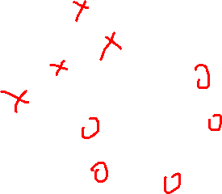
Logistic Regression: Recap
We want to predict the probability that the engine will work.
Will this engine work?
Do this using Logistic Regression

Slide 27
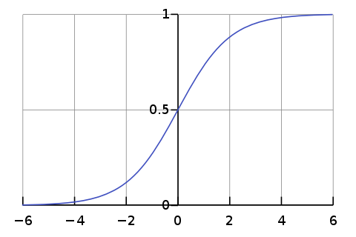
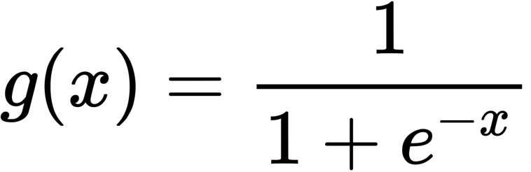
Linear regression or Logistic Regression?
We want to predict a probability that is either 0 = 0% or 1 = 100%.
Linear regression gave us a value that is not between 0 and 1
$$\hat{y}=w_{1}x_{1}+w_{2}x_{2}+w_{3}x_{3}+…+w_{n}x_{n}+b \text{=} W^{T}X\text{+}\text{b}$$
Wrap the result of the linear regression with another function.
In a neural network, this is called the Activation Function
Logistic Function

Slide 28

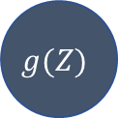
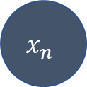
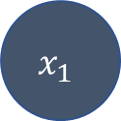



Logistic Regression as a NN
We can represent Logisitic Regression as a Simple Neural Network
$$x_{1}$$
$$⋮$$
$${Z=W}^{T}X+b$$
$$g(Z)$$
$$\hat{y}$$
$$x_{n}$$
$$b$$

Slide 29




Logistic regression: the model
Logistic regression model:
Sigmoid function:
Forward Propagation
b
w
$$Z=W^{T}X+b$$
$$A=g(Z)$$
$$\hat{y}=A$$
$$Loss$$
Output from linear regression
Wrapping the output around an activation function
The probability that the engine works is represented by g(Z)
We still need to define a Loss function

Slide 30
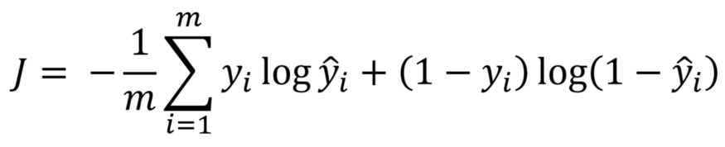
Logistic Regression Loss Function
A measure of how "badly" the model performed.
Logistic Regression uses a "Cross Entropy" Loss Function
$y_{i}$ Label for the i-th example | ${\hat{y}}_{i}$ Prediction for the i-th example
Credit: https://towardsdatascience.com/step-by-step-guide-to-building-your-own-neural-network-from-scratch-df64b1c5ab6e
Notes:
Give a "spoiler" of sorts by starting with this diagram.
Usually, people use these terms interchangeably. But each word has its own nuance. (And then briefly explain the diagram).
How I envision this lecture and this series of lectures is essentially starting from the bigger picture and then constantly working our way down; our whole lecture series are structured in this way (By using lots of real life examples). I want to first start off by talking about what artificial intelligence is in general and then start by scratching the surface of ML. Lecture 2 will get more into Machine Learning, where the lecture will be based on a real project, teaching some useful Python Packages. Then after that, we will cover all of ML. After covering ML, we will move onto Neural Networks and Deep learning (where arguably all the exciting projects and case studies are)

Slide 31
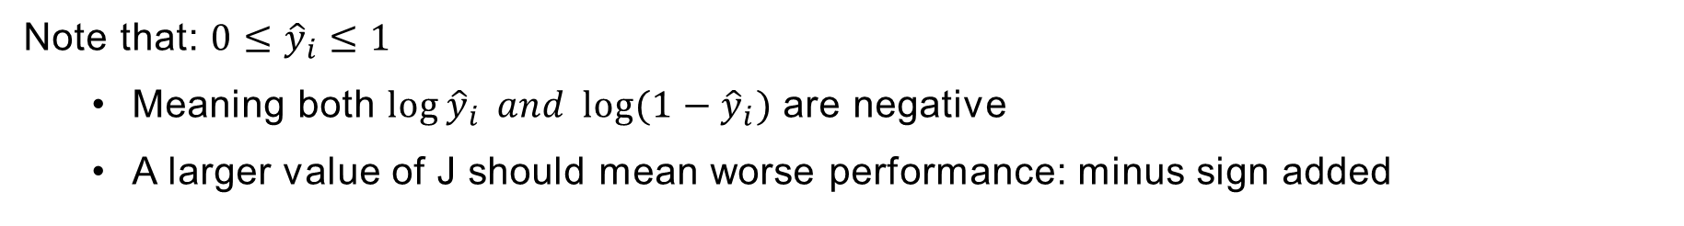
Loss Function
Average over all m examples
Loss for one example
Note that: ${0≤\hat{y}}_{i}≤1$
Meaning both $\log{{\hat{y}}_{i}} and \log{(1−{\hat{y}}_{i})}$ are negative
A larger value of J should mean worse performance: minus sign added
Notes:
Give a "spoiler" of sorts by starting with this diagram.
Usually, people use these terms interchangeably. But each word has its own nuance. (And then briefly explain the diagram).
How I envision this lecture and this series of lectures is essentially starting from the bigger picture and then constantly working our way down; our whole lecture series are structured in this way (By using lots of real life examples). I want to first start off by talking about what artificial intelligence is in general and then start by scratching the surface of ML. Lecture 2 will get more into Machine Learning, where the lecture will be based on a real project, teaching some useful Python Packages. Then after that, we will cover all of ML. After covering ML, we will move onto Neural Networks and Deep learning (where arguably all the exciting projects and case studies are)

Slide 32
Loss Function
Notes:
Give a "spoiler" of sorts by starting with this diagram.
Usually, people use these terms interchangeably. But each word has its own nuance. (And then briefly explain the diagram).
How I envision this lecture and this series of lectures is essentially starting from the bigger picture and then constantly working our way down; our whole lecture series are structured in this way (By using lots of real life examples). I want to first start off by talking about what artificial intelligence is in general and then start by scratching the surface of ML. Lecture 2 will get more into Machine Learning, where the lecture will be based on a real project, teaching some useful Python Packages. Then after that, we will cover all of ML. After covering ML, we will move onto Neural Networks and Deep learning (where arguably all the exciting projects and case studies are)

Slide 33
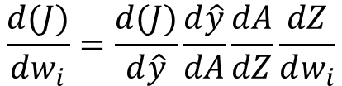



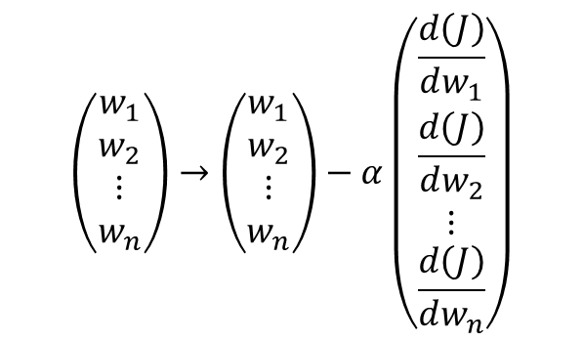



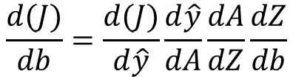
Backpropagation in Logistic Regression
b
W
$$Z=W^{T}X+b$$
$$A=g(Z)$$
$$\hat{y}=A$$
$J(\hat{y}$)
We need to compute:
$$\frac{d(J)}{dw_{1}};\frac{d(J)}{dw_{2}};…;\frac{d\left(J\right)}{dw_{n}};\frac{d(J)}{db}$$
$$\frac{d(J)}{dw_{i}}=\frac{d(J)}{d\hat{y}}\frac{d\hat{y}}{dA}\frac{dA}{dZ}\frac{dZ}{dw_{i}}$$
$$\frac{d(J)}{db}=\frac{d(J)}{d\hat{y}}\frac{d\hat{y}}{dA}\frac{dA}{dZ}\frac{dZ}{db}$$
$$\left(\begin{matrix}\begin{matrix}w_{1} \\ w_{2}\end{matrix} \\ ⋮ \\ w_{n}\end{matrix}\right)→\left(\begin{matrix}\begin{matrix}w_{1} \\ w_{2}\end{matrix} \\ ⋮ \\ w_{n}\end{matrix}\right)−α\left(\begin{matrix}\begin{matrix}\frac{d\left(J\right)}{dw_{1}} \\ \frac{d\left(J\right)}{dw_{2}}\end{matrix} \\ ⋮ \\ \frac{d\left(J\right)}{dw_{n}}\end{matrix}\right)$$
$W→W−αdW$
$$b→b−α\frac{d(MSE)}{db}$$
Notes:
Give a "spoiler" of sorts by starting with this diagram.
Usually, people use these terms interchangeably. But each word has its own nuance. (And then briefly explain the diagram).
How I envision this lecture and this series of lectures is essentially starting from the bigger picture and then constantly working our way down; our whole lecture series are structured in this way (By using lots of real life examples). I want to first start off by talking about what artificial intelligence is in general and then start by scratching the surface of ML. Lecture 2 will get more into Machine Learning, where the lecture will be based on a real project, teaching some useful Python Packages. Then after that, we will cover all of ML. After covering ML, we will move onto Neural Networks and Deep learning (where arguably all the exciting projects and case studies are)

Slide 34
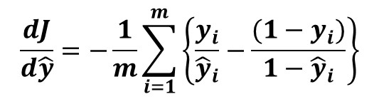
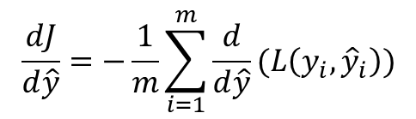
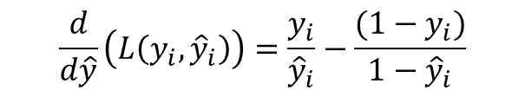
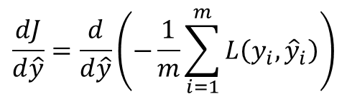
Loss Function Derivative
Determine $\frac{dJ}{d\hat{y}}:$Let $L\left(y_{i},{\hat{y}}_{i}\right)=y_{i}\log{{\hat{y}}_{i}}+(1−y_{i})\log{(1−{\hat{y}}_{i})}$
$$\frac{dJ}{d\hat{y}}=\frac{d}{d\hat{y}}\left(−\frac{1}{m}\sum_{i=1}^{m}{L\left(y_{i},{\hat{y}}_{i}\right)}\right)$$
$$\frac{dJ}{d\hat{y}}=−\frac{1}{m}\sum_{i=1}^{m}{\frac{d}{d\hat{y}}}(L\left(y_{i},{\hat{y}}_{i}\right))$$
$$\frac{d}{d\hat{y}}\left(L\left(y_{i},{\hat{y}}_{i}\right)\right)=\frac{y_{i}}{{\hat{y}}_{i}}−\frac{(1−y_{i})}{1−{\hat{y}}_{i}}$$
$$\frac{dJ}{d\hat{y}}=−\frac{1}{m}\sum_{i=1}^{m}{\left\{\frac{y_{i}}{{\hat{y}}_{i}}−\frac{(1−y_{i})}{1−{\hat{y}}_{i}}\right\}}$$
Notes:
Give a "spoiler" of sorts by starting with this diagram.
Usually, people use these terms interchangeably. But each word has its own nuance. (And then briefly explain the diagram).
How I envision this lecture and this series of lectures is essentially starting from the bigger picture and then constantly working our way down; our whole lecture series are structured in this way (By using lots of real life examples). I want to first start off by talking about what artificial intelligence is in general and then start by scratching the surface of ML. Lecture 2 will get more into Machine Learning, where the lecture will be based on a real project, teaching some useful Python Packages. Then after that, we will cover all of ML. After covering ML, we will move onto Neural Networks and Deep learning (where arguably all the exciting projects and case studies are)

Slide 35
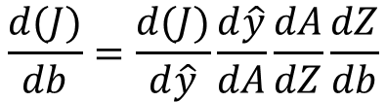
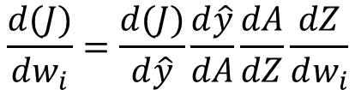
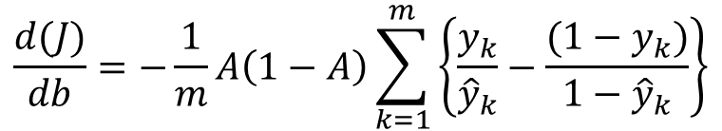
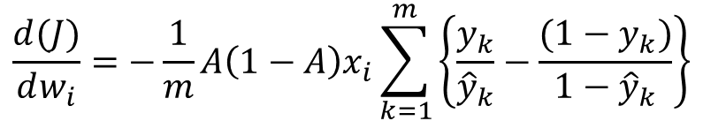
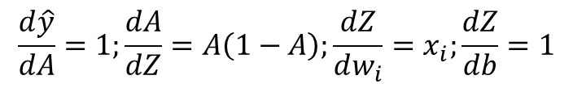
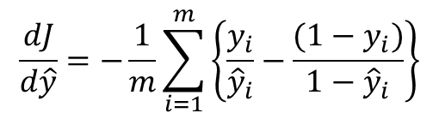
Backpropagation in Logistic Regression
b
W
$$Z=W^{T}X+b$$
$$A=g(Z)$$
$$\hat{y}=A$$
$J(\hat{y}$)
Now compute the derivatives
$$\frac{d(J)}{dw_{i}}=\frac{d(J)}{d\hat{y}}\frac{d\hat{y}}{dA}\frac{dA}{dZ}\frac{dZ}{dw_{i}}$$
$$\frac{d(J)}{db}=\frac{d(J)}{d\hat{y}}\frac{d\hat{y}}{dA}\frac{dA}{dZ}\frac{dZ}{db}$$
$$\frac{dJ}{d\hat{y}}=−\frac{1}{m}\sum_{i=1}^{m}{\left\{\frac{y_{i}}{{\hat{y}}_{i}}−\frac{(1−y_{i})}{1−{\hat{y}}_{i}}\right\}}$$
$$\frac{d\hat{y}}{dA}=1;\frac{dA}{dZ}=A\left(1−A\right);\frac{dZ}{dw_{i}}=x_{i};\frac{dZ}{db}=1$$
$$\frac{d(J)}{dw_{i}}=−\frac{1}{m}A\left(1−A\right)x_{i}\sum_{k=1}^{m}{\left\{\frac{y_{k}}{{\hat{y}}_{k}}−\frac{(1−y_{k})}{1−{\hat{y}}_{k}}\right\}}$$
$$\frac{d(J)}{db}=−\frac{1}{m}A\left(1−A\right)\sum_{k=1}^{m}{\left\{\frac{y_{k}}{{\hat{y}}_{k}}−\frac{(1−y_{k})}{1−{\hat{y}}_{k}}\right\}}$$
Notes:
Give a "spoiler" of sorts by starting with this diagram.
Usually, people use these terms interchangeably. But each word has its own nuance. (And then briefly explain the diagram).
How I envision this lecture and this series of lectures is essentially starting from the bigger picture and then constantly working our way down; our whole lecture series are structured in this way (By using lots of real life examples). I want to first start off by talking about what artificial intelligence is in general and then start by scratching the surface of ML. Lecture 2 will get more into Machine Learning, where the lecture will be based on a real project, teaching some useful Python Packages. Then after that, we will cover all of ML. After covering ML, we will move onto Neural Networks and Deep learning (where arguably all the exciting projects and case studies are)

Slide 36



Logistic Regression
In Summary:
X
w
A
$$\hat{y}$$
1.Random Initialisation: Neural Network assigns random values to W and b.
2.Forward Propagation: The Network Calculates:
$Z=W^{T}X+b ;A=g\left(Z\right); \hat{y}=A$
3.Backpropagation: The network calculates derivatives to minimise the loss function
$$\frac{d(J)}{dw_{i}}=\frac{d(J)}{d\hat{y}}\frac{d\hat{y}}{dA}\frac{dA}{dZ}\frac{dZ}{dw_{i}}$$
$$\frac{d(MSE)}{db}=\frac{d(MSE)}{d\hat{y}}\frac{d\hat{y}}{dA}\frac{dA}{dZ}\frac{dZ}{db}$$
4.Update Parameters: Using the gradients, parameters (w,b) are updated
$$w →w−αdW$$
$$b→b−α\frac{d(MSE)}{db}$$
5.Repeat 2-4 for a set number of “Epochs”
Notes:
Give a "spoiler" of sorts by starting with this diagram.
Usually, people use these terms interchangeably. But each word has its own nuance. (And then briefly explain the diagram).
How I envision this lecture and this series of lectures is essentially starting from the bigger picture and then constantly working our way down; our whole lecture series are structured in this way (By using lots of real life examples). I want to first start off by talking about what artificial intelligence is in general and then start by scratching the surface of ML. Lecture 2 will get more into Machine Learning, where the lecture will be based on a real project, teaching some useful Python Packages. Then after that, we will cover all of ML. After covering ML, we will move onto Neural Networks and Deep learning (where arguably all the exciting projects and case studies are)

Slide 37















What about General NNs?
Linear Regression
Logistic Regression (Classification)
$$x_{1}$$
$$x_{1}$$
$${Z=W}^{T}X+b$$
$${Z=W}^{T}X+b$$
$$⋮$$
$$⋮$$
Z
$$\hat{y}$$
$$g(Z)$$
$$\hat{y}$$
$$x_{n}$$
$$x_{n}$$
$$\hat{y}=Z$$
$$\hat{y}=g(Z)$$
$$b$$
$$b$$
See that a neural network can function as a regressor or a classifier
It only depends on which activation function we are using!
Credit: https://medium.com/@marcellvollmer/how-to-make-it-simple-to-explain-ai-ml-dl-and-data-science-a49e54d54a12
Notes:
Give a "spoiler" of sorts by starting with this diagram.
Usually, people use these terms interchangeably. But each word has its own nuance. (And then briefly explain the diagram).
How I envision this lecture and this series of lectures is essentially starting from the bigger picture and then constantly working our way down; our whole lecture series are structured in this way (By using lots of real life examples). I want to first start off by talking about what artificial intelligence is in general and then start by scratching the surface of ML. Lecture 2 will get more into Machine Learning, where the lecture will be based on a real project, teaching some useful Python Packages. Then after that, we will cover all of ML. After covering ML, we will move onto Neural Networks and Deep learning (where arguably all the exciting projects and case studies are)

Slide 38
General NNs

Slide 39
What about General NNs?
Until now, we only considered problems where there are only 1 neuron and 1 hidden layer.
This is also known as a perceptron
$$x_{1}$$
$$x_{1}$$
$${Z=W}^{T}X+b$$
$${Z=W}^{T}X+b$$
$$⋮$$
$$⋮$$
Z
$$\hat{y}$$
$$g(Z)$$
$$\hat{y}$$
$$x_{n}$$
$$x_{n}$$
$$\hat{y}=Z$$
$$\hat{y}=g(Z)$$
$$b$$
$$b$$
What about general neural networks?
Credit: https://medium.com/@marcellvollmer/how-to-make-it-simple-to-explain-ai-ml-dl-and-data-science-a49e54d54a12
Notes:
Give a "spoiler" of sorts by starting with this diagram.
Usually, people use these terms interchangeably. But each word has its own nuance. (And then briefly explain the diagram).
How I envision this lecture and this series of lectures is essentially starting from the bigger picture and then constantly working our way down; our whole lecture series are structured in this way (By using lots of real life examples). I want to first start off by talking about what artificial intelligence is in general and then start by scratching the surface of ML. Lecture 2 will get more into Machine Learning, where the lecture will be based on a real project, teaching some useful Python Packages. Then after that, we will cover all of ML. After covering ML, we will move onto Neural Networks and Deep learning (where arguably all the exciting projects and case studies are)

Slide 40

Some (More) Notation
Input, Label Matrix: $X, Y$
Prediction Matrix: $\hat{y}$
Number Of Layers: All layers excluding input
Input Layer: Layer 0
Number of examples: m
Input, Label Size: $n_{x},$ $n_{y}$
Values in layer L is denoted by: $W^{[L]}$
Number of neurons in (hidden) layer L: $n_{h}^{[L]}$
Credit: https://medium.com/@marcellvollmer/how-to-make-it-simple-to-explain-ai-ml-dl-and-data-science-a49e54d54a12
Notes:
Give a "spoiler" of sorts by starting with this diagram.
Usually, people use these terms interchangeably. But each word has its own nuance. (And then briefly explain the diagram).
How I envision this lecture and this series of lectures is essentially starting from the bigger picture and then constantly working our way down; our whole lecture series are structured in this way (By using lots of real life examples). I want to first start off by talking about what artificial intelligence is in general and then start by scratching the surface of ML. Lecture 2 will get more into Machine Learning, where the lecture will be based on a real project, teaching some useful Python Packages. Then after that, we will cover all of ML. After covering ML, we will move onto Neural Networks and Deep learning (where arguably all the exciting projects and case studies are)

Slide 41
General NNs
Consider Input Layer to hidden layer 1 and number each hidden neuron 1 to 4 with some activation function $g^{\left[1\right]}(x)$
1
2
3
4
$$A_{1}^{[1]}=g^{[1]}\left(Z_{1}^{[1]}\right);where Z_{1}^{[1]}=w_{1,1}x_{1}+w_{2,1}x_{2}+{w_{3,1}x_{3}+b}_{1}=W_{1}^{\left[1\right]T}X+b_{1}$$
$$A_{2}^{[1]}=g^{[1]}\left(Z_{2}^{[1]}\right);where Z_{2}^{[1]}=w_{1,2}x_{1}+w_{2,2}x_{2}+{w_{3,2}x_{3}+b}_{2}=W_{2}^{\left[1\right]T}X+b_{2}$$
$$A_{3}^{[1]}=g^{[1]}\left(Z_{3}^{[1]}\right);where Z_{3}^{[1]}=w_{1,3}x_{1}+w_{2,3}x_{2}+{w_{3,3}x_{3}+b}_{3}=W_{3}^{\left[1\right]T}X+b_{3}$$
$$A_{4}^{[1]}=g^{[1]}\left(Z_{4}^{[1]}\right);where Z_{4}^{[1]}=w_{1,4}x_{1}+w_{2,4}x_{2}+{w_{3,4}x_{3}+b}_{4}=W_{4}^{\left[1\right]T}X+b_{4}$$
Notes:
Give a "spoiler" of sorts by starting with this diagram.
Usually, people use these terms interchangeably. But each word has its own nuance. (And then briefly explain the diagram).
How I envision this lecture and this series of lectures is essentially starting from the bigger picture and then constantly working our way down; our whole lecture series are structured in this way (By using lots of real life examples). I want to first start off by talking about what artificial intelligence is in general and then start by scratching the surface of ML. Lecture 2 will get more into Machine Learning, where the lecture will be based on a real project, teaching some useful Python Packages. Then after that, we will cover all of ML. After covering ML, we will move onto Neural Networks and Deep learning (where arguably all the exciting projects and case studies are)

Slide 42
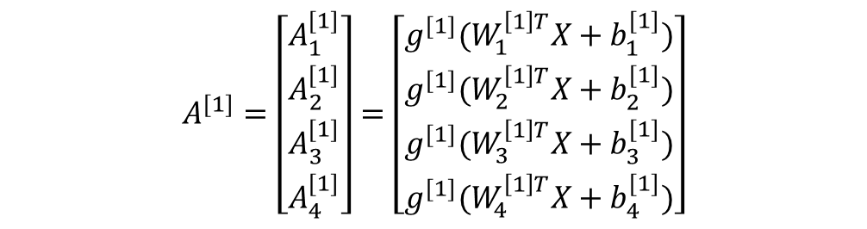
General NNs
Consider Input Layer to hidden layer 1 and number each hidden neuron 1 to 4 with some activation function g(x)
1
2
3
4
$$A^{[1]}=\left[\begin{matrix}\begin{matrix}A_{1}^{[1]} \\ A_{2}^{[1]}\end{matrix} \\ A_{3}^{[1]} \\ A_{4}^{[1]}\end{matrix}\right]=\left[\begin{matrix}\begin{matrix}g^{[1]}(W_{1}^{\left[1\right]T}X+b_{1}^{[1]}) \\ g^{[1]}(W_{2}^{\left[1\right]T}X+b_{2}^{[1]})\end{matrix} \\ g^{[1]}(W_{3}^{\left[1\right]T}X+b_{3}^{[1]}) \\ g^{[1]}(W_{4}^{\left[1\right]T}X+b_{4}^{[1]})\end{matrix}\right]$$
Now $A^{[1]}$ acts as the input for hidden layer 2
Notes:
Give a "spoiler" of sorts by starting with this diagram.
Usually, people use these terms interchangeably. But each word has its own nuance. (And then briefly explain the diagram).
How I envision this lecture and this series of lectures is essentially starting from the bigger picture and then constantly working our way down; our whole lecture series are structured in this way (By using lots of real life examples). I want to first start off by talking about what artificial intelligence is in general and then start by scratching the surface of ML. Lecture 2 will get more into Machine Learning, where the lecture will be based on a real project, teaching some useful Python Packages. Then after that, we will cover all of ML. After covering ML, we will move onto Neural Networks and Deep learning (where arguably all the exciting projects and case studies are)

Slide 43
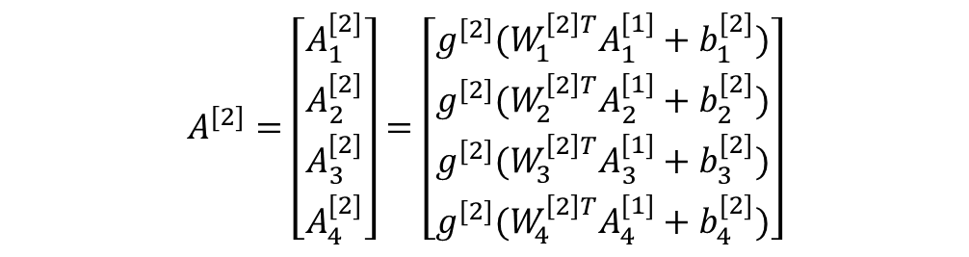
General NNs
Now consider Hidden Layer 1 to Hidden Layer 2. Follow similar logic to previous slides, using $g^{\left[2\right]}\left(x\right)$ as the activation function:
1
2
3
4
$$A^{[2]}=\left[\begin{matrix}\begin{matrix}A_{1}^{[2]} \\ A_{2}^{[2]}\end{matrix} \\ A_{3}^{[2]} \\ A_{4}^{[2]}\end{matrix}\right]=\left[\begin{matrix}\begin{matrix}g^{[2]}(W_{1}^{\left[2\right]T}A_{1}^{[1]}+b_{1}^{[2]}) \\ g^{[2]}(W_{2}^{\left[2\right]T}A_{2}^{[1]}+b_{2}^{[2]})\end{matrix} \\ g^{[2]}(W_{3}^{\left[2\right]T}A_{3}^{[1]}+b_{3}^{[2]}) \\ g^{[2]}(W_{4}^{\left[2\right]T}A_{4}^{[1]}+b_{4}^{[2]})\end{matrix}\right]$$
Notes:
Give a "spoiler" of sorts by starting with this diagram.
Usually, people use these terms interchangeably. But each word has its own nuance. (And then briefly explain the diagram).
How I envision this lecture and this series of lectures is essentially starting from the bigger picture and then constantly working our way down; our whole lecture series are structured in this way (By using lots of real life examples). I want to first start off by talking about what artificial intelligence is in general and then start by scratching the surface of ML. Lecture 2 will get more into Machine Learning, where the lecture will be based on a real project, teaching some useful Python Packages. Then after that, we will cover all of ML. After covering ML, we will move onto Neural Networks and Deep learning (where arguably all the exciting projects and case studies are)

Slide 44


General NNs
Finally for the output layer with activation function $g^{\left[3\right]}\left(x\right)$ :
$${\hat{y}={g^{\left[3\right]}(W}^{\left[3\right]T}A}^{[2]}+b^{\left[3\right]})$$
A general neural network will have to assign random values for:$W^{\left[1\right]};W^{\left[2\right]};W^{\left[3\right]}{;b}^{\left[1\right]};b^{\left[2\right]};b^{\left[3\right]}$
And then calculate derivatives for all parameters and then update using:
$W→W−αdW$
$$b→b−α\frac{d(Loss)}{db}$$
Notes:
Give a "spoiler" of sorts by starting with this diagram.
Usually, people use these terms interchangeably. But each word has its own nuance. (And then briefly explain the diagram).
How I envision this lecture and this series of lectures is essentially starting from the bigger picture and then constantly working our way down; our whole lecture series are structured in this way (By using lots of real life examples). I want to first start off by talking about what artificial intelligence is in general and then start by scratching the surface of ML. Lecture 2 will get more into Machine Learning, where the lecture will be based on a real project, teaching some useful Python Packages. Then after that, we will cover all of ML. After covering ML, we will move onto Neural Networks and Deep learning (where arguably all the exciting projects and case studies are)

Slide 45
Activation Functions

Slide 46
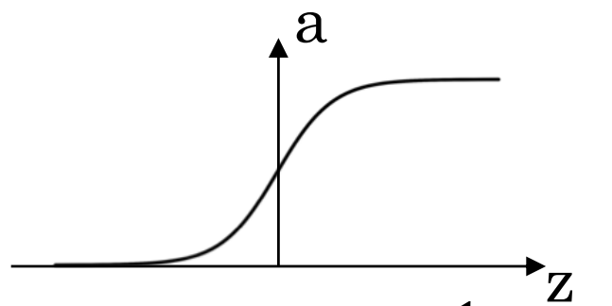




Activation Functions
Sigmoid Function
$$\tanh{(Z)}$$
1
1
Z
-1
$$g\left(Z\right)=\frac{1}{1+e^{−Z}}$$
$$g\left(Z\right)=\tanh\left(Z\right)=\frac{e^{Z}−e^{−Z}}{e^{Z}+e^{−Z}}$$
Generally, only used for the output layer in a binary classification problem
Credit: deeplearning.ai
Notes:
Give a "spoiler" of sorts by starting with this diagram.
Usually, people use these terms interchangeably. But each word has its own nuance. (And then briefly explain the diagram).
How I envision this lecture and this series of lectures is essentially starting from the bigger picture and then constantly working our way down; our whole lecture series are structured in this way (By using lots of real life examples). I want to first start off by talking about what artificial intelligence is in general and then start by scratching the surface of ML. Lecture 2 will get more into Machine Learning, where the lecture will be based on a real project, teaching some useful Python Packages. Then after that, we will cover all of ML. After covering ML, we will move onto Neural Networks and Deep learning (where arguably all the exciting projects and case studies are)

Slide 47




Activation Functions
ReLU
Leaky ReLU
$$g\left(Z\right)=\left\{\begin{aligned}Z if Z≥0 \\ 0 if Z<0\end{aligned}\right.$$
$$g\left(Z\right)=\left\{\begin{aligned}Z if Z≥0 \\ βZ if Z<0\end{aligned}\right.$$
When in doubt, use ReLU
Tends to perform better than just ReLU
Easy to implement, closest to how a Neuron actually works
But 1 more hyperparameter to tune
Credit: deeplearning.ai
Notes:
Give a "spoiler" of sorts by starting with this diagram.
Usually, people use these terms interchangeably. But each word has its own nuance. (And then briefly explain the diagram).
How I envision this lecture and this series of lectures is essentially starting from the bigger picture and then constantly working our way down; our whole lecture series are structured in this way (By using lots of real life examples). I want to first start off by talking about what artificial intelligence is in general and then start by scratching the surface of ML. Lecture 2 will get more into Machine Learning, where the lecture will be based on a real project, teaching some useful Python Packages. Then after that, we will cover all of ML. After covering ML, we will move onto Neural Networks and Deep learning (where arguably all the exciting projects and case studies are)

Slide 48
Questions?

Slide 49
Extra reading
Learning rate does not always have to be constant
Optimisers such as “Adam” or “RMSProp” slowly change the value of the learning rate
https://medium.com/analytics-vidhya/a-complete-guide-to-adam-and-rmsprop-optimizer-75f4502d83be
To prevent overfitting: you can modify the Loss function using L1 or L2 Regularisation
https://towardsdatascience.com/l1-and-l2-regularization-methods-ce25e7fc831c
Matrix Calculus: This lecture used a simplified version of Neural networks to keep the maths simple. In reality, Matrix Calculus is needed.
https://explained.ai/matrix-calculus/
Credit: deeplearning.ai
Notes:
Give a "spoiler" of sorts by starting with this diagram.
Usually, people use these terms interchangeably. But each word has its own nuance. (And then briefly explain the diagram).
How I envision this lecture and this series of lectures is essentially starting from the bigger picture and then constantly working our way down; our whole lecture series are structured in this way (By using lots of real life examples). I want to first start off by talking about what artificial intelligence is in general and then start by scratching the surface of ML. Lecture 2 will get more into Machine Learning, where the lecture will be based on a real project, teaching some useful Python Packages. Then after that, we will cover all of ML. After covering ML, we will move onto Neural Networks and Deep learning (where arguably all the exciting projects and case studies are)

